Slide 1
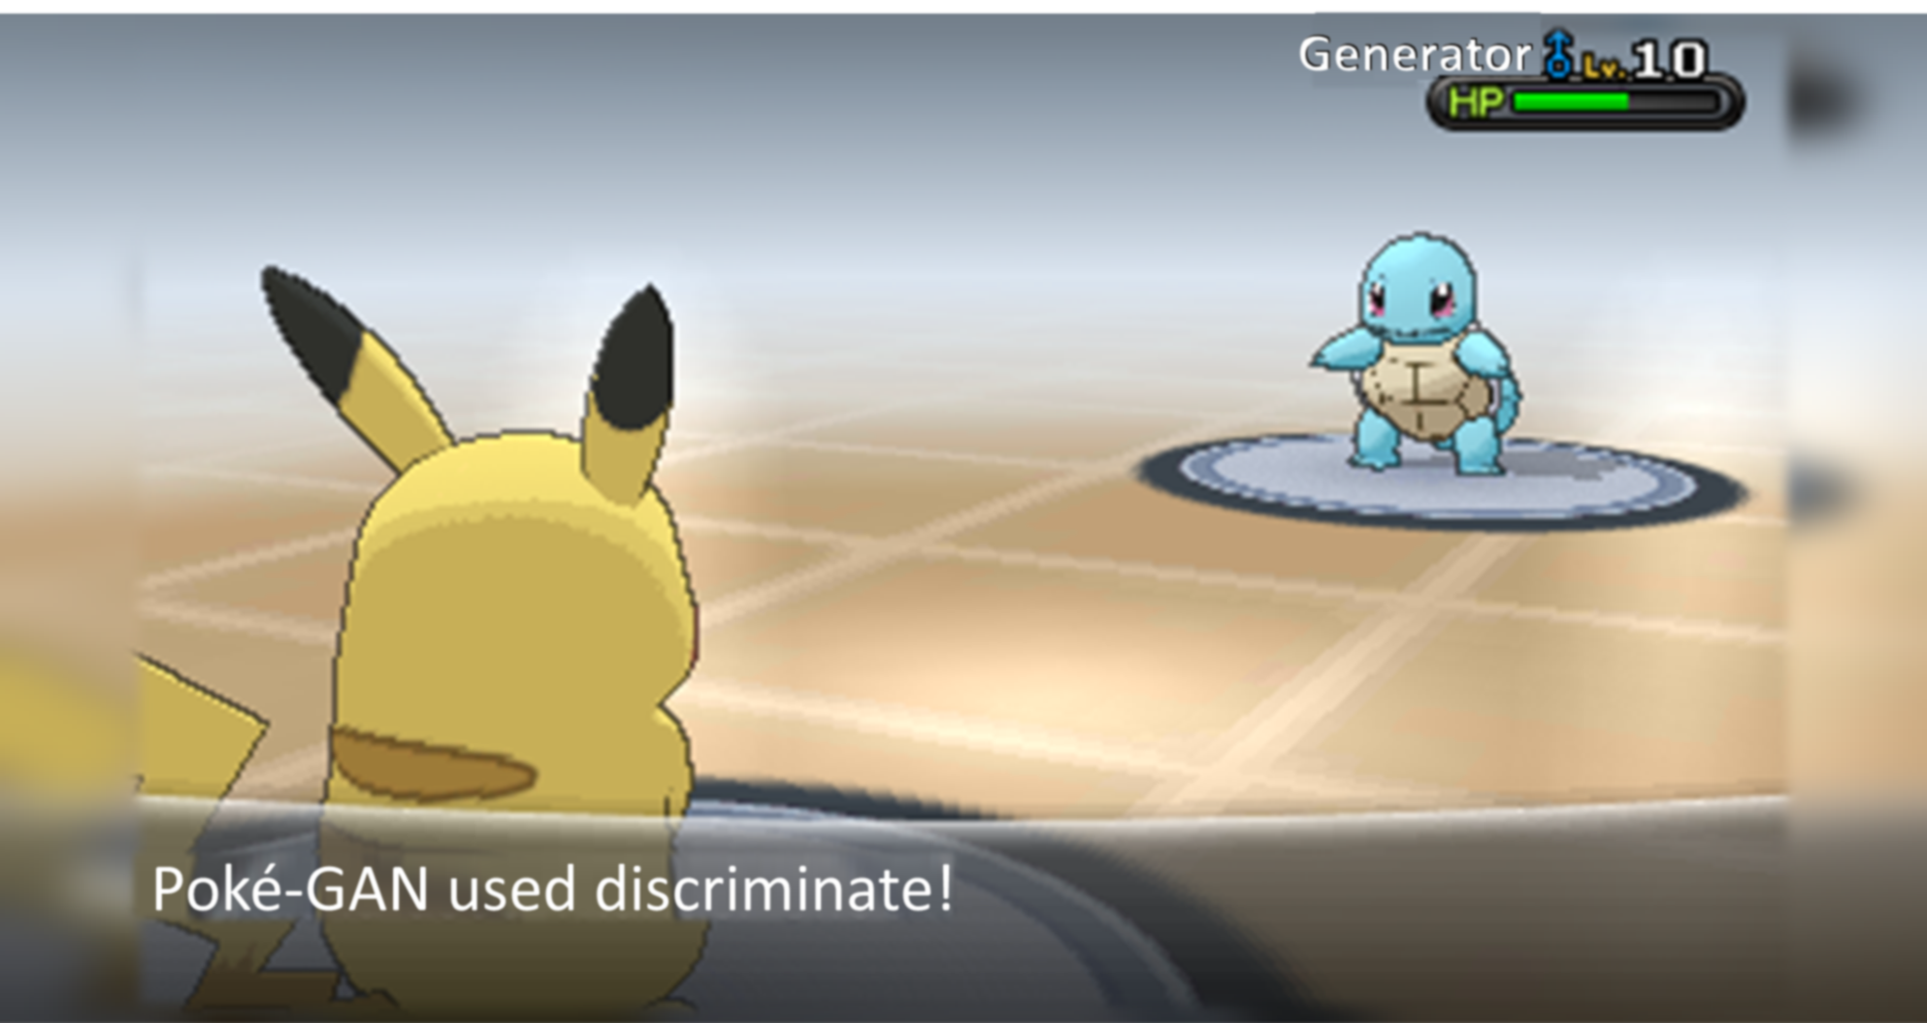

Poké-GAN
CITS 4404 PROJECT PRESENTATION
SEM2, 2020

Slide 2





MEET THE TEAM
MARK GABRIEL
TOM WAKEFIELD
M MARZUKI M KAMAL
HO YIN HO
github.com/markangelogabriel/pokemon-type-gan

Slide 3



PROJECT OBJECTIVES
Gotta catch generate them all!
Build the world’s best conditional Pokémon GAN
1
2
3
UNDERSTAND EXISTING RESEARCH IN THIS AREA
FIND THE RIGHT DATA
BUILD & TRAIN THE MODEL
An audit of existing research in this area will build our understanding of what has already been implemented, and what works best. We can also identify what we can add to the existing body of research.
The audit will include researching existing Pokémon GANs, conditional GANs, and other modern GAN approaches that work well, but which haven’t yet been applied to this problem.
A conditional GAN requires a labelled dataset for training.
An online search will be required to find publicly available Pokémon image repositories. We may be lucky and find labelled images, otherwise we will need to manually label the images.
We will also consider data augmentation to get the most out of our data.
We aim to bring together the best research learnings and apply them to our problem.
We must explore a broad range of promising GAN architectures from which we can observe performance and select the best.
With the best architecture, we must also test a broad range of optimisation approaches so that we can refine and calibrate our model for maximum performance.

Slide 4
PROJECT FLOW
EXPLORE the topic
BUILD models
OPTIMISE
Audit existing research on:
- Conditional GANs
- Pokémon GANs
- Cartoon GANs
- WGANs
Collect data.
Build multiple candidate GAN models in parallel:
- Build a standard GAN
- Build a conditional GAN
- Build a WGAN
- Use transfer-learning
DEFINE the objective
SELECT the best
FINALISE
Seek performance gains for the best GAN model:
- Hyper-parameter selection
- Up/down-sampling
- Tweak structure
- Data Augmentation
“Build the world’s best conditional Pokémon GAN.”
The best-performing candidate GAN is selected to progress to the optimisation stage.
- Test & record results
- Document

Slide 5
SECTION 1
UNDERSTAND EXISTING RESEARCH

Slide 6
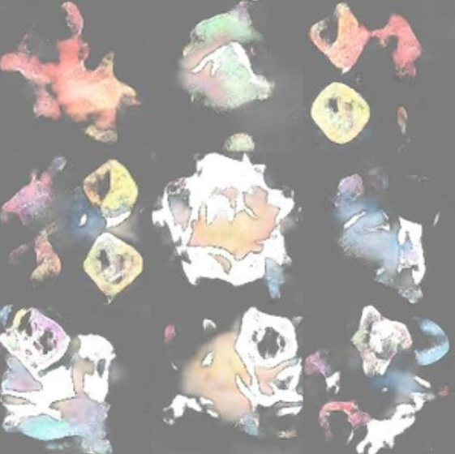
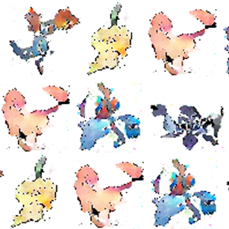
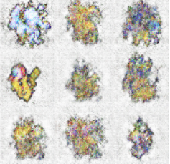
Pokémon GANs It’s nothing new, but they’re not very good
EXISTING SOLUTION 1:
EXISTING SOLUTION 2:
EXISTING SOLUTION 3:
As described by Siraj Raval in one of his YouTube videos
Uses a WGAN to generate Pokémon images
Source: https://github.com/llSourcell/Pokemon_GAN https://www.youtube.com/watch?v=yz6dNf7X7SA
Uses a DCGAN to generate Pokémon images
The posted solution had a nice image set which we have used as our training images
Source: https://github.com/kvpratama/gan/tree/master/pokemon
A simple GAN architecture to generate Pokémon images
Images categorized into type before training one type only at a time
Source: https://medium.com/neuronio/creating-pokemon-with-artificial-intelligence-d080fa89835b

Slide 7
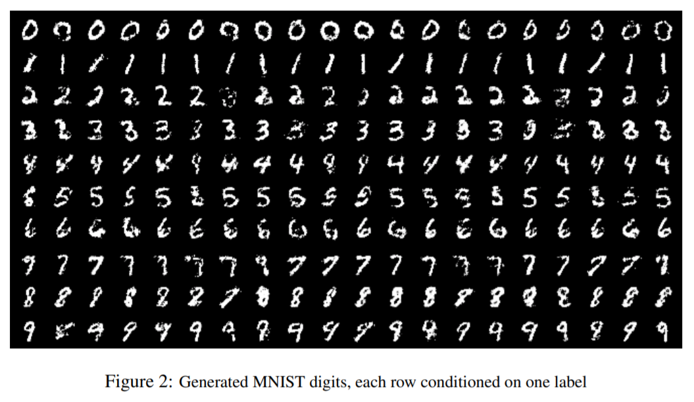
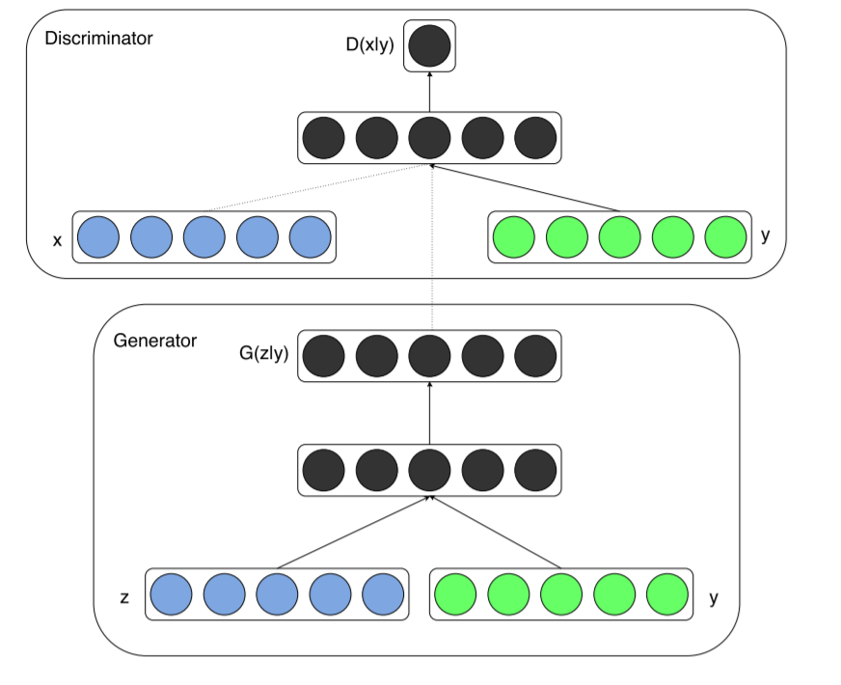
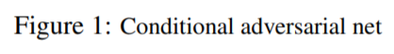
Conditional GANs
To extend existing Pokémon research
Description: This paper introduces the conditional version of generative adversarial nets, and shows that they can generate MNIST digits conditioned on class labels.
In addition to data x, the generator and discriminator are conditioned on some extra information y. The authors feed y into the both the discriminator and generator as an additional input layer.
In the generator, the prior input noise and y are combined in a joint hidden representation. In the discriminator, x and y are presented as inputs to a discriminative function.
Relevance: Our goal is to apply conditional GANs to Pokémon, conditioning on type – a rare approach in Pokémon image generation. This paper explains the fundamental concepts that will underpin our GAN architecture.
Source: Conditional Generative Adversarial Nets: Mehdi Mirza, Simon Osindero (https://arxiv.org/abs/1411.1784)

Slide 8
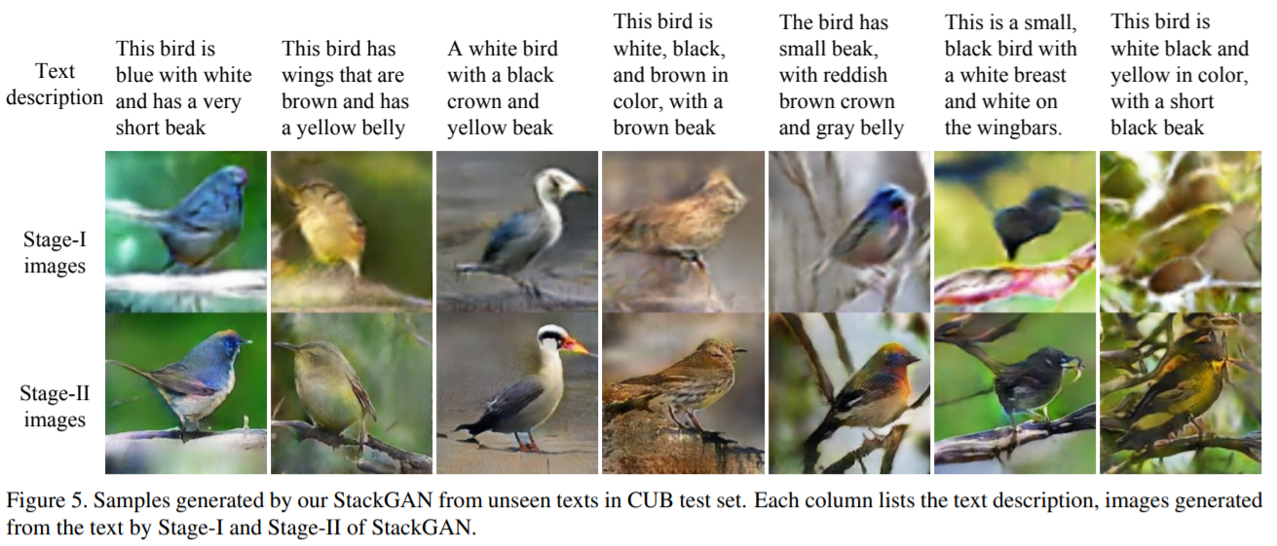
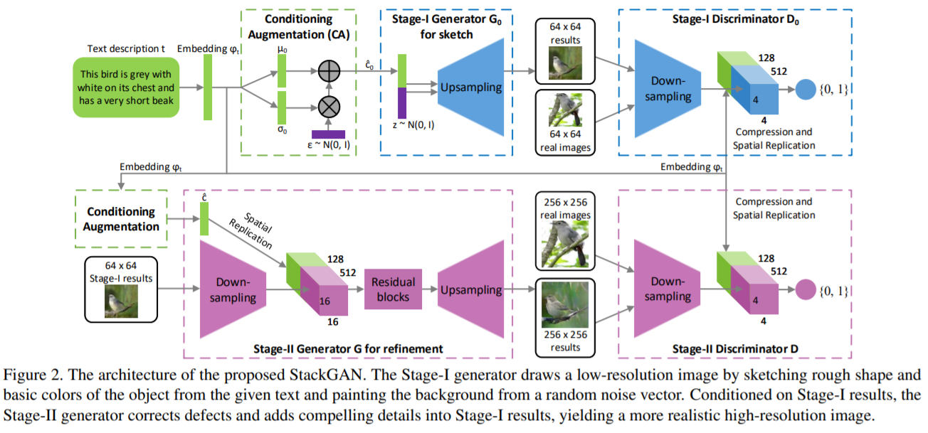
StackGAN
Existing research that gave us confidence that a quality result was achievable
Description: A Stacked Generative Adversarial Networks (StackGAN) that generates 256×256 photo-realistic images conditioned on text descriptions.
The text description is first encoded by an encoder, yielding a text embedding ϕt.
The Stage-I GAN sketches the primitive shape and colours of the object based on the given text description, yielding Stage-I low-resolution images.
The Stage-II GAN takes Stage-I results and text descriptions as inputs, and generates high-resolution images with photo-realistic details.
Relevance: Our Pokémon conditioning information is simpler as it does not require text embedding. A simplified version of their architecture should work if applied to our dataset.
Source: StackGAN: Text to Photo-realistic Image Synthesis with Stacked Generative Adversarial Networks: Han Zhang, Tao Xu, Hongsheng Li, Shaoting Zhang, Xiaogang Wang, Xiaolei Huang, Dimitris Metaxas (https://arxiv.org/abs/1612.03242)

Slide 9
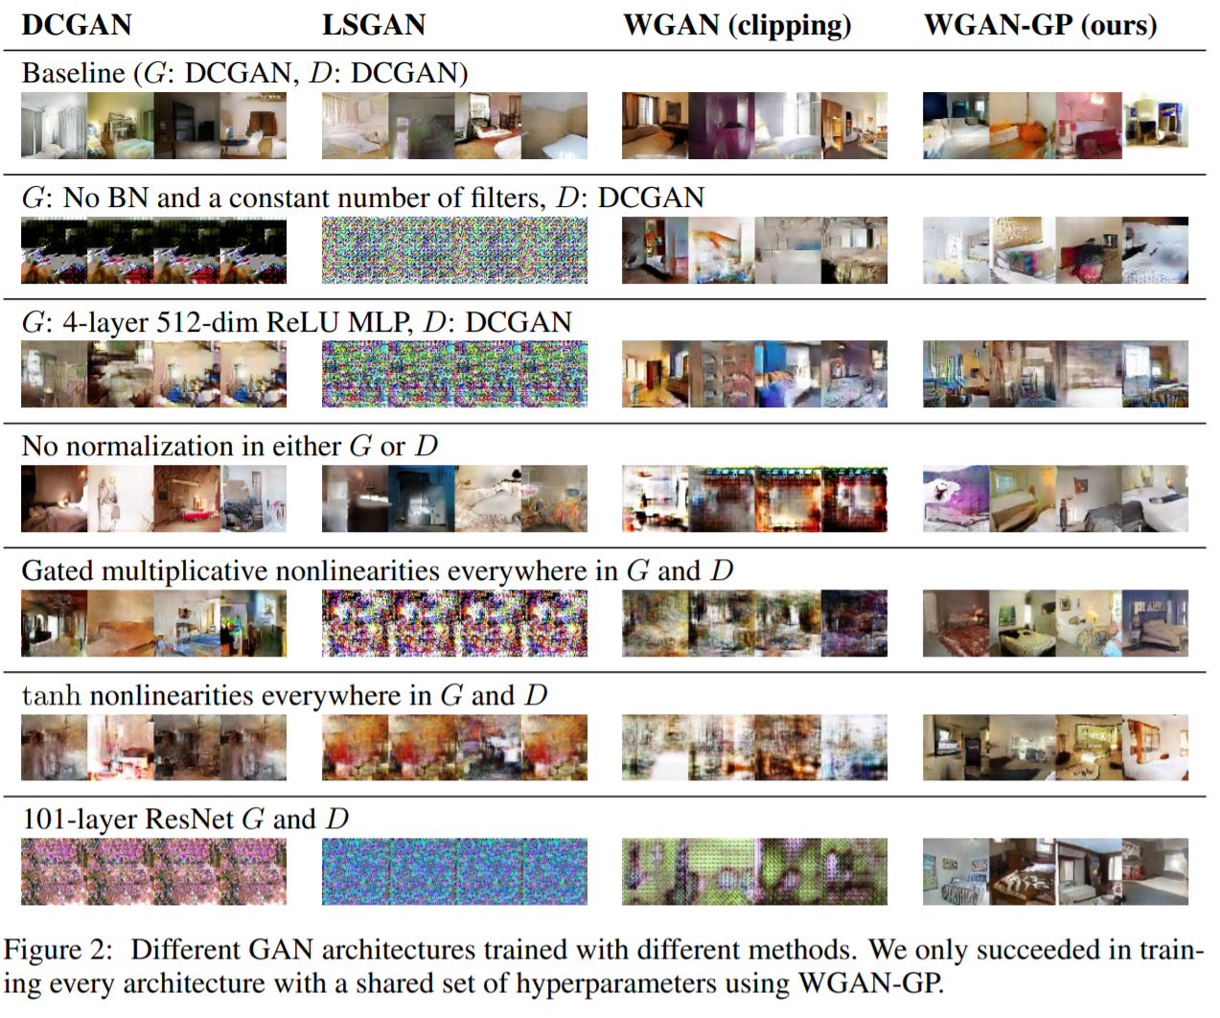
WGANs
A modern GAN architecture delivering high-quality, detailed images
Description: WGANs use a novel definition of the loss function, involving the Wasserstein distance, that improves training performance.
A WGAN delivers:
a meaningful loss metric that correlates with the generator’s convergence and sample quality
improved stability of the optimization process
Relevance: In order for our Pokémon images to look as realistic as possible, a modern, high-performing GAN architecture is needed.
Sources: Wasserstein GAN: Martin Arjovsky, Soumith Chintala, Léon Bottou (https://arxiv.org/abs/1701.07875)
Improved Training of Wasserstein GANs: Ishaan Gulrajani, Faruk Ahmed, Martin Arjovsky, Vincent Dumoulin, Aaron Courville (https://arxiv.org/pdf/1704.00028)

Slide 10
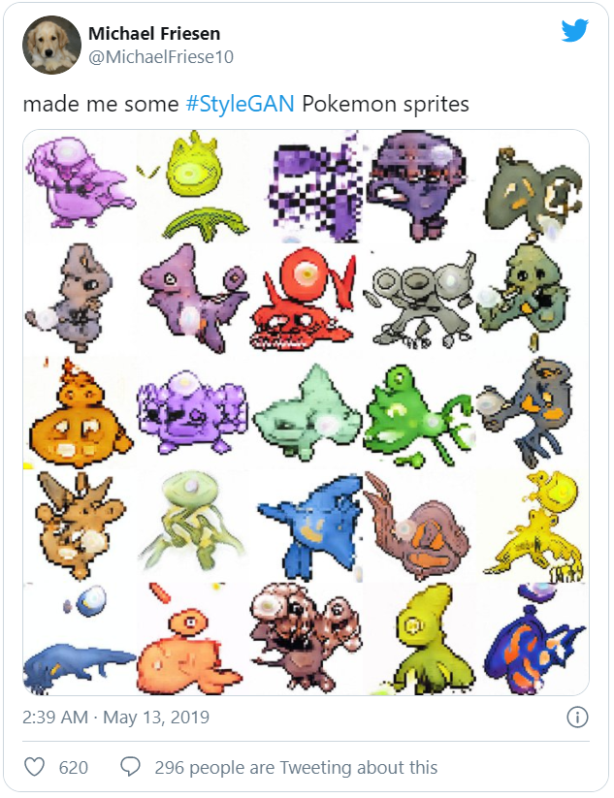
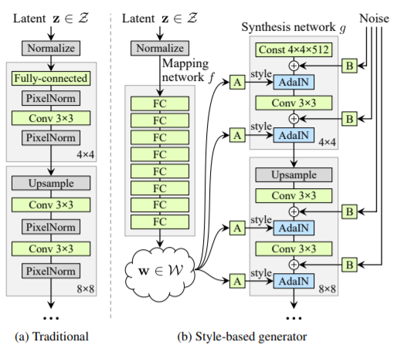
Transfer Learning
StyleGAN is an open-source network
Description: NVIDIA Research has open-sourced their ‘StyleGAN’ code, and we found that others had already used it to produce Pokémon images.
Their style-based generator leads to an automatically learned, unsupervised separation of high-level attributes (e.g. pose and identity when trained on human faces) and stochastic variation in the generated images (e.g. freckles, hair). It also enables intuitive, scale-specific control of the synthesis.
The code is implemented in TensorFlow and training time was about 1 week on an Nvidia DGX-1 (RRP $129,000).
Relevance: We may be able to transfer acquired knowledge from this existing network trained on a much larger dataset of images. This may serve as a good starting point for our network to train on our limited dataset.
Sources: https://github.com/NVlabs/stylegan/commits/master
https://twitter.com/MichaelFriese10/status/1127614400750346240
A Style-Based Generator Architecture for Generative Adversarial Networks: Tero Karras, Samuli Laine, Timo Aila (https://arxiv.org/abs/1812.04948)

Slide 11

PROJECT FOCUS AREAS Key elements that we SOUGHT TO implement FOR our project
BUILDING THE WORLD’S BEST CONDITIONAL POKÉMON GAN
APPLY A CONDITIONAL GAN TO A POKEMON DATASET
CONDITION ON TYPE
IMPLEMENT A WGAN
A rare approach in the field of Pokémon image generation.
The Generator will learn features of 18 Pokémon types. Pokémon may be multi-type, and we should be able to generate novel combinations.
Wasserstein GANs are an alternative to traditional GAN training that improves the stability of learning with a new loss function
Building on this paper: https://arxiv.org/abs/1411.1784
With reference to this paper: https://arxiv.org/pdf/1704.00028
APPLY TRANSER LEARNING
UP & DOWN SAMPLING
We may not need to invent the entire wheel.
A smart way to address image-size issues.
With reference to this paper: https://arxiv.org/abs/1812.04948
With reference to this paper: https://arxiv.org/abs/1612.03242

Slide 12
SECTION 2
OUR DATA

Slide 13

OUR TRAINING DATA
819 Pokémon images taken from Kaggle:
Generations I, II, III, IV, V, VI
256x256 images with transparent backgrounds
https://www.kaggle.com/kvpratama/pokemon-images-dataset
We manually annotated Pokémon type for each image using lists from Wikipedia:
https://en.wikipedia.org/wiki/List_of_generation_I_Pok%C3%A9mon
https://en.wikipedia.org/wiki/List_of_generation_II_Pok%C3%A9mon
https://en.wikipedia.org/wiki/List_of_generation_III_Pok%C3%A9mon
https://en.wikipedia.org/wiki/List_of_generation_IV_Pok%C3%A9mon
https://en.wikipedia.org/wiki/List_of_generation_V_Pok%C3%A9mon
https://en.wikipedia.org/wiki/List_of_generation_VI_Pok%C3%A9mon
18 Pokémon types:
Each Pokémon can have up to two type labels
Horizontal-flip data augmentation applied
This effectively doubles our training data to 1,638 images
Rotation data augmentation applied
Random rotation in the range [-10, 10] degrees

Slide 14

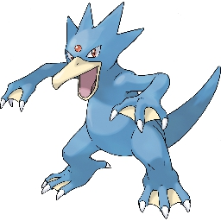
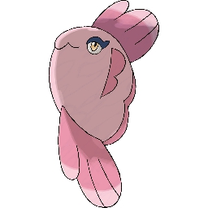

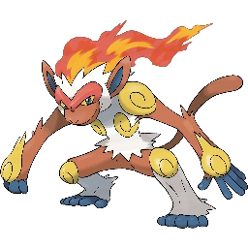



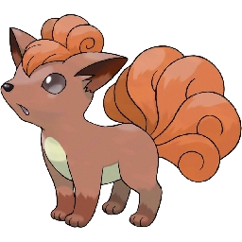


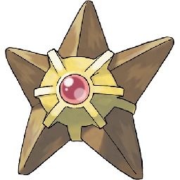

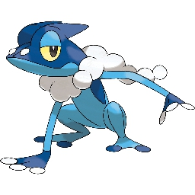
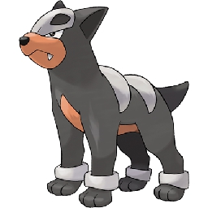

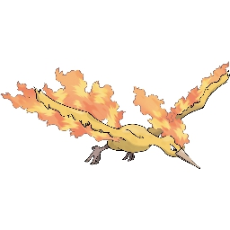

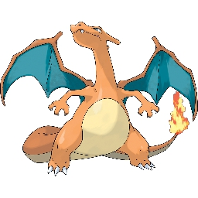



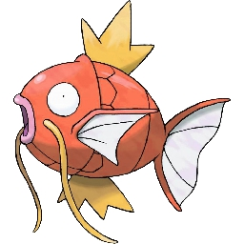


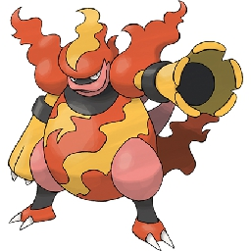


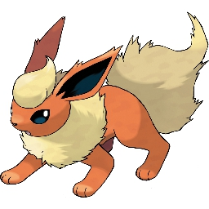



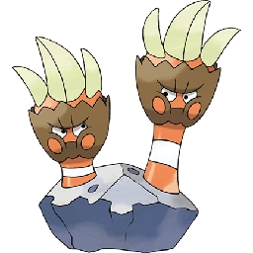
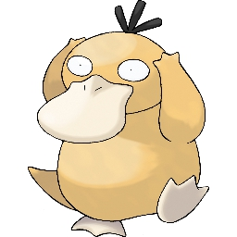
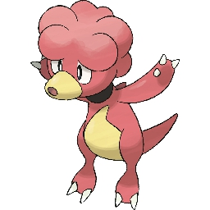
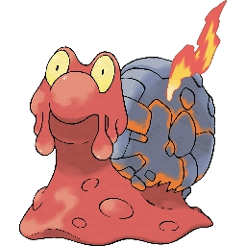

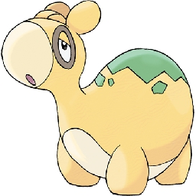


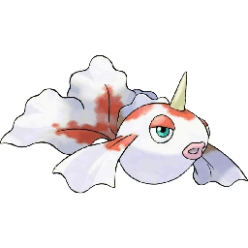



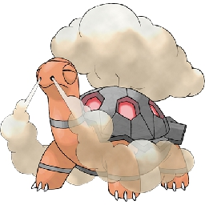

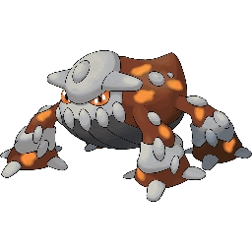
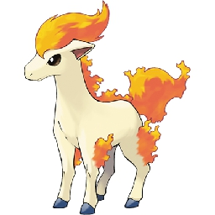

TRAINING DATA EXAMPLES
WATER-TYPE
FIRE-TYPE
Also a Fire-type

Slide 15
SECTION 3
MODEL BUILDING

Slide 16
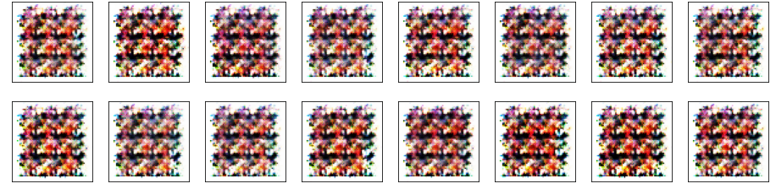
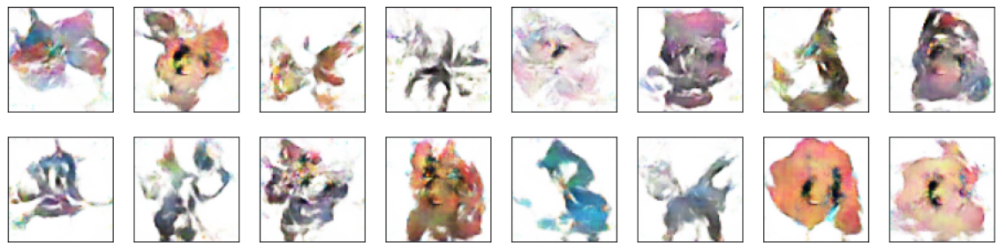
WE STARTED WITH A NORMAL Pokémon GAN
A standard GAN (not conditional) based on deep convolutional neural networks DCGAN.
Structure:
5-layer discriminator with batch norm and leaky ReLU.
5-layer generator with batch norm and normal ReLU.
Hyper-parameters set based on recommendations in this paper: https://arxiv.org/pdf/1511.06434
Performance:
Figure 1: Bad performance initially
Figure 2: Reasonable performance after optimisation and more epochs
Learnings:
Successfully built our own a Pokémon image generation GAN
…it’s possible!
Figure 1: Initial results
Figure 2: Final results after 500 epochs

Slide 17
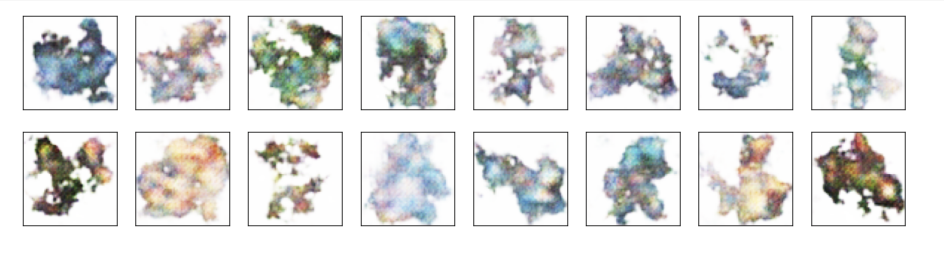
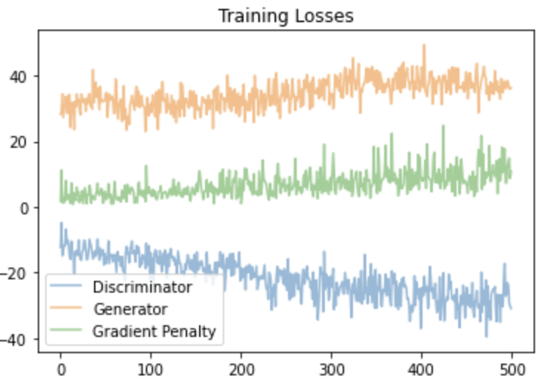
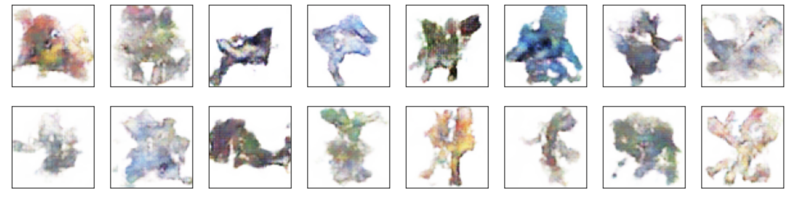
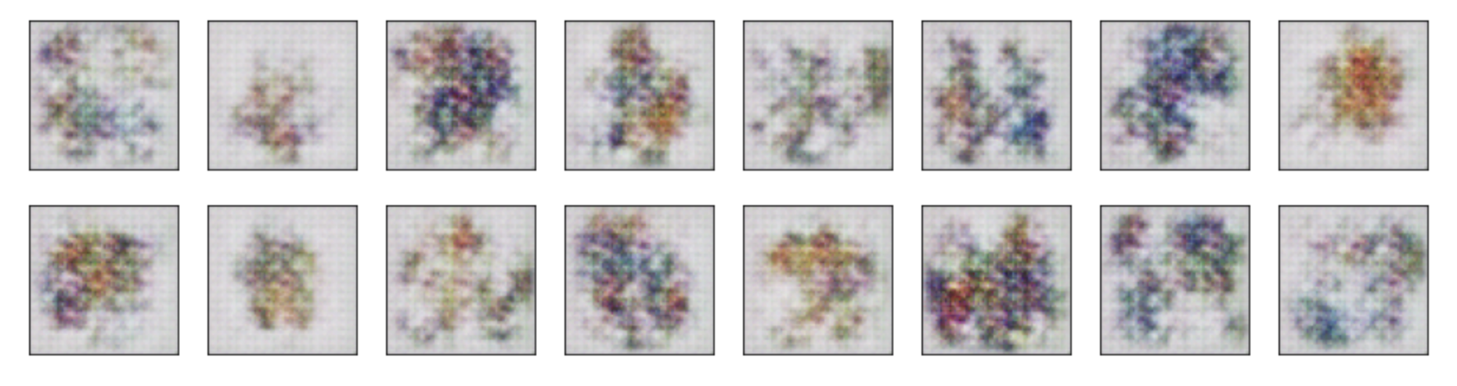
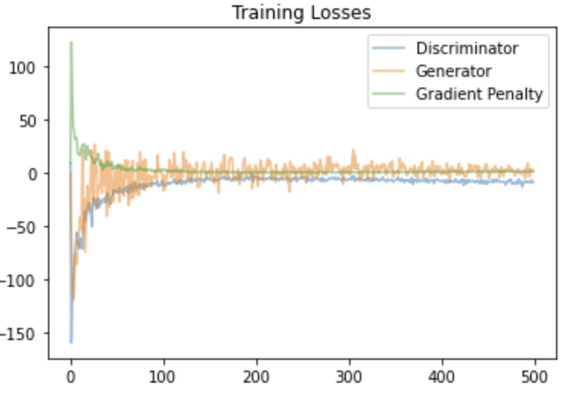
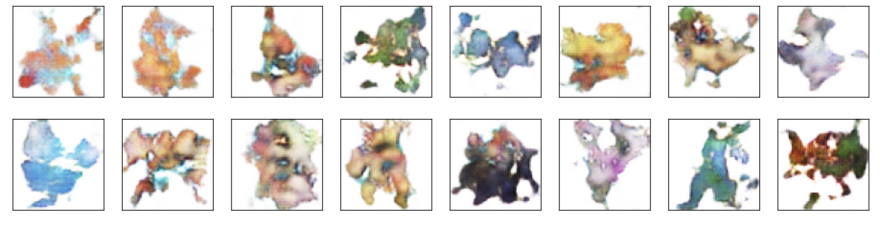
THEN WE BUILT A WGAN SEEKING BETTER QUALITY IMAGES
A standard WGAN (not conditional) based on deep convolutional neural networks, with the WGAN loss function and gradient penalty (the newer, improved WGAN architecture).
Performance:
Fig 1: Average performance initially, but no mode collapse.
Fig 2a: Slightly more detail in images, but loss not converging (Fig 2b). Uses normalisation (InstanceNorm2d).
Fig 3: Implementing a different normalisation (layernorm) not promising after 50 epochs, loss function was not converging either.
Fig 4a: No normalisation with n = 500 epochs delivers quality images and a converging loss function (Fig4b).
Learnings:
WGAN improves the quality of Pokémon images
Normalisation affects loss convergence, best performance was with no normalisation.
Around 300-500 epochs is optimal, substantially more or less reduces quality
Figure 1: Initial results
Figure 2a: Results after 500 epochs with InstanceNorm2d
Figure 2b: Loss not converging to zero
Figure 3: Results with normalisation (layernorm) at 50 epochs
Figure 4a: Results after 500 epochs with no normalisation
Figure 4b: Loss converging to zero

Slide 18
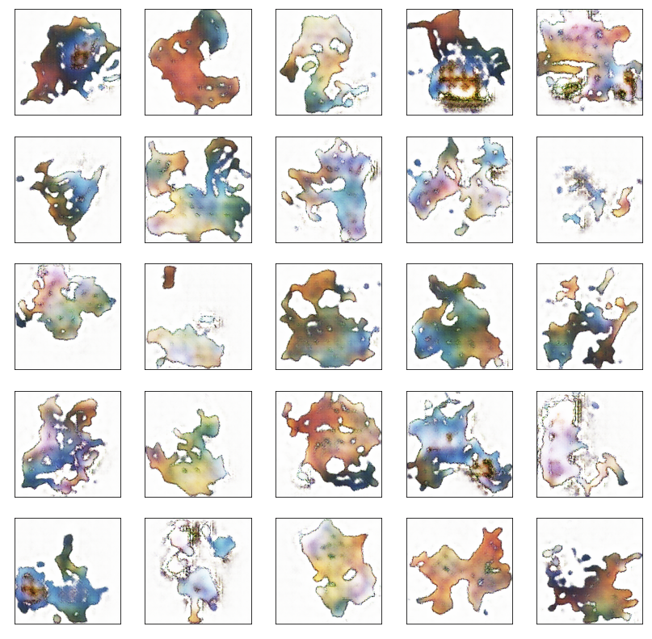
WE REPLICATED THE STACKGAN ARCHITECTURE
We recreated stackGAN with labels instead of word embeddings and the architecture included ‘up-sampling’ to 256x256. Took too long to train and results weren’t good enough to pursue further.
Performance:
Fig 1: Results not very promising after 60 epochs. But, it generated much stronger black outlines than previously
Learnings:
Too slow to train
Good recreation of the black outlines
Figure 1: Results after 60 epochs
Source: StackGAN: Text to Photo-realistic Image Synthesis with Stacked Generative Adversarial Networks: Han Zhang, Tao Xu, Hongsheng Li, Shaoting Zhang, Xiaogang Wang, Xiaolei Huang, Dimitris Metaxas (https://arxiv.org/abs/1612.03242)

Slide 19
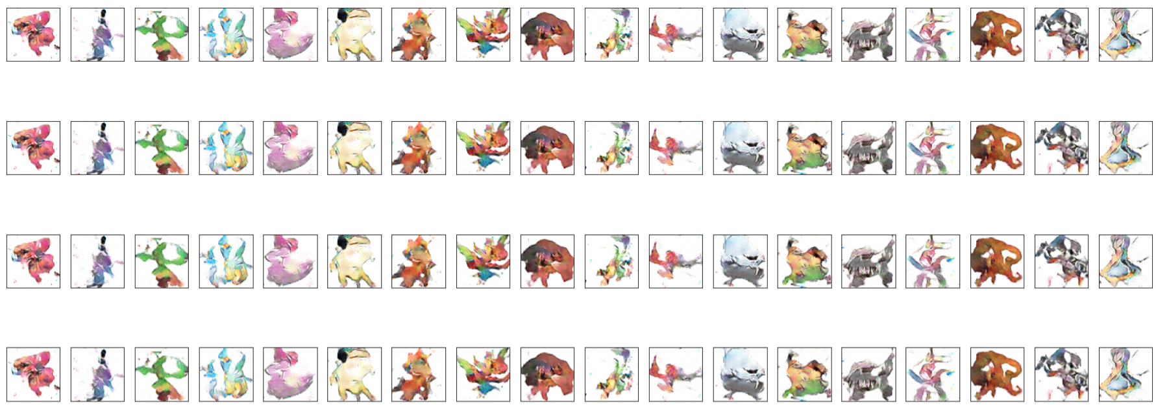
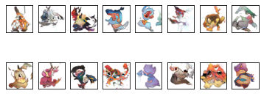
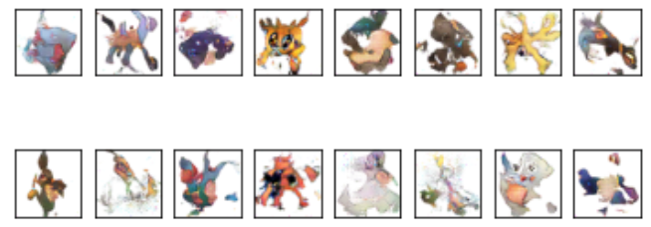
WE BUILT A CONDITIONAL GAN
We built a conditional GAN based on relatively standard deep convolutional layers.
Structure:
5-layer discriminator with batch norm, leaky ReLU, and dropout.
5-layer generator with batch norm and normal ReLU.
Feature map size: 64
Channels: 3 (colours)
Hyper-parameters guided by this paper: https://arxiv.org/pdf/1511.06434.pdf
Performance:
Figure 1: Bad performance initially, with mode collapse happening often
Figure 2: Performance improved after optimisation and more epochs
Learnings:
Successfully built a conditional Pokémon GAN!
Images are low quality, but are expressing type-dependent variation and some are believable as Pokemon
Selected as the best model to optimise
Figure 1: Initial results – mode collapse
Figure 2: Results after 900 epochs, no mode collapse

Slide 20
TRANSFER LEARNING DIDN’T WORK
Practical constraints prevented us from integrating StyleGAN
StyleGAN is implemented in TensorFlow, whereas our implementation is in PyTorch
We do not have access to a high-end GPU
“We recommend NVIDIA DGX-1 with 8 Tesla V100 GPUs.”¹
Sources: 1. https://github.com/NVlabs/stylegan/blob/master/README.md

Slide 21
FINAL MODEL – TESTED OPTIMISATIONS
We took our conditional GAN, the best performer, and optimised it to build our final model.
Optimisations tested:
Data augmentation
Rotation
Horizontal flipping
Hyper-parameter selection
Noisy labels (randomly flips the label when training discriminator)
Soft noise (0-0.3 instead of 0 for fake images, 0.7-1.3 for real images)
Dropout in all generator layers
Leaky reLU everywhere

Slide 22
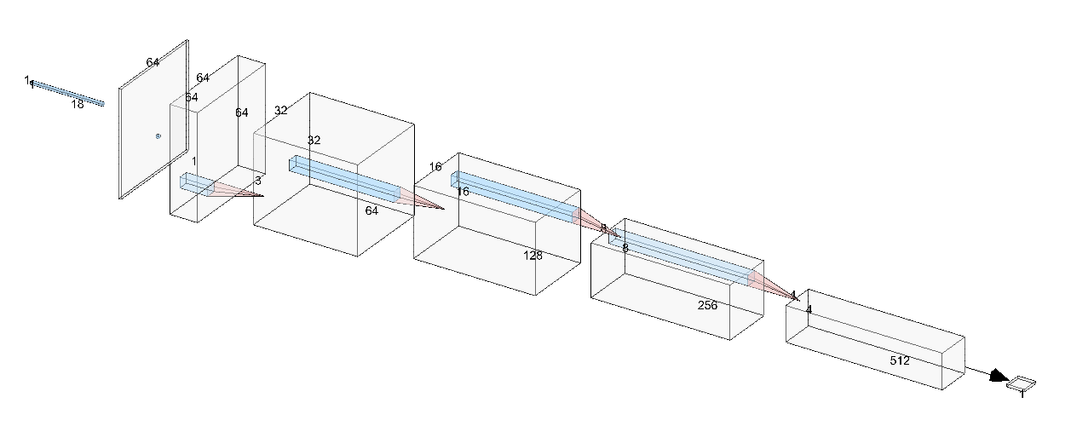
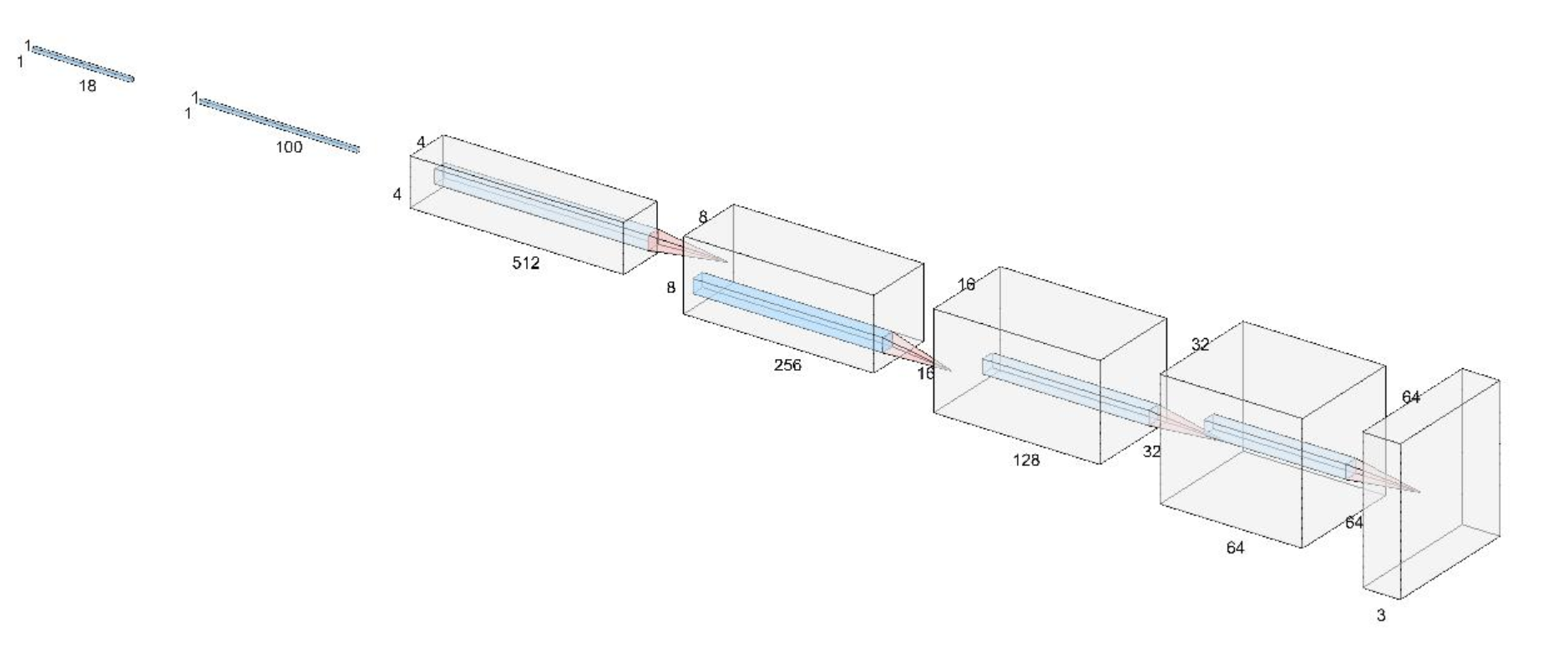

FINAL MODEL
Conv2d
Leaky ReLU
REAL SAMPLE
Label is transformed to 64x64x1, then appended to the image
DISCRIMINATOR
Conv2d
Batchnorm
Leaky ReLU
label (1x1x18)
Image (64x64x3)
Conv2d
Batchnorm
Leaky ReLU
Conv2d
Batchnorm
Leaky ReLU
Dropout
GENERATOR
Label (condition)
Label is transformed to 64x64x1, then appended to the image
Sigmoid
Z (latent vector)
1
Real / Fake
Conv2dtranspose
Batchnorm
ReLU
Generated image
Conv2dtranspose
Batchnorm
ReLU
Conv2dtranspose
Batchnorm
ReLU
Conv2dtranspose
Batchnorm
ReLU
Tanh

Slide 23
SECTION 4
FINAL MODEL RESULTS

Slide 24
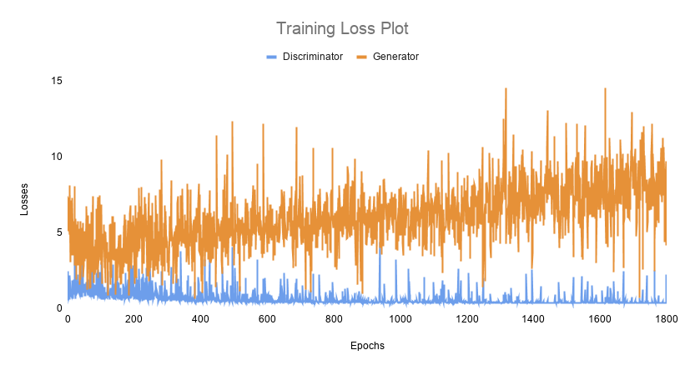
TRAINING
Training took approximately 1 hour 10 mins for 1,800 epochs (Google colab)
We reached the GPU memory limit at 900 epochs, so had to save and reload to continue training
We trained up to 6,300 epochs, but the best looking images were from the model at 1800 epochs
Unfortunately, our generator rarely generated Pokémon that fooled the discriminator (p > 0.5)

Slide 25
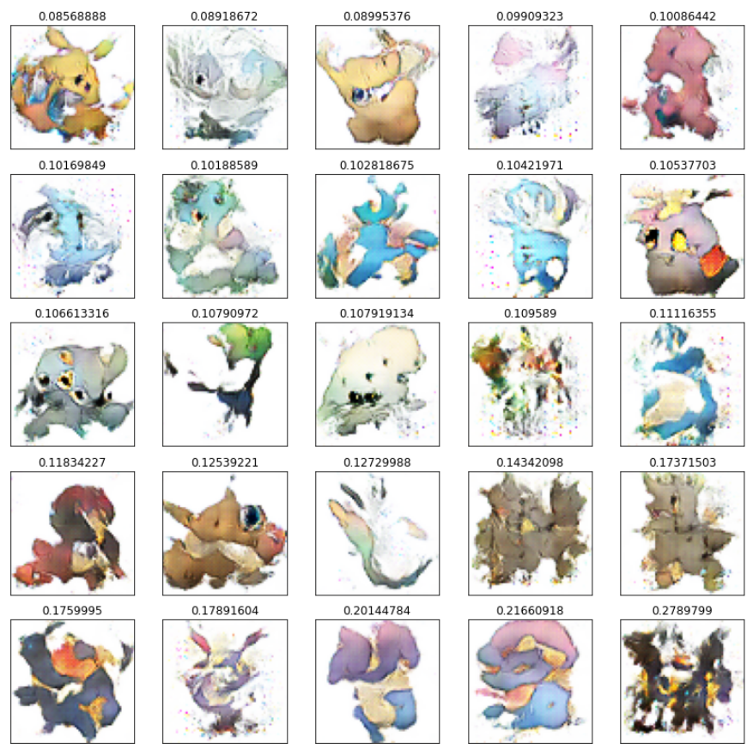

























GENERATED Water POKEMON WERE NOT COMPARABLE TO REAL POKEMON…
REAL
GENERATED
Notes: 1. 2,000 water Pokémon were generated, and the 25 best scoring images are shown here

Slide 26
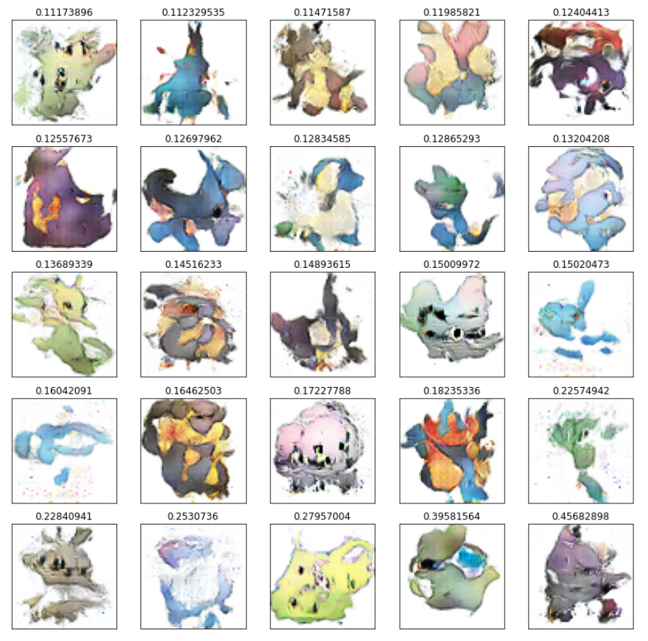

























…NOR WERE GENERATED FIRE POKEMON
REAL
GENERATED
Notes: 1. 2,000 fire Pokémon were generated, and the 25 best scoring images are shown here

Slide 27






HOWEVER, OUR POKEMON ARE MORE CONVINCING THAN OTHER SOLUTIONS
EXISTING SOLUTION 1:
GENERATED FROM FINAL MODEL:
FROM A DISTANCE:
UP CLOSE:
EXISTING SOLUTION 2:
EXISTING SOLUTION 3:

Slide 28









HUMAN-SELECTED COMPARISONS SHOW SOME PROMISING RESULTS
real
generated
BUG
FLYING
BUG
DRAGON
ICE
DRAGON
ICE
ICE
ELECTRIC FIRE
ELECTRIC
FIRE
FIRE

Slide 29










…HUMAN-SELECTED COMPARISONS CONT.
real
generated
GHOST
GHOST
ROCK
ROCK
WATER
WATER
BUG
BUG
GRASS POISON
POISON

Slide 30
SUMMARY
SUCCESS…
…LIMITED SUCCESS
DATASET ISSUES
TYPES NOT CLEAR
RESOURCES
The final model did exhibit both conditional learning, and could generate somewhat realistic Pokémon.
Our generator is not capable of consistently fooling the discriminator. The generated images tend to get scores in the 0.001 – 0.2 probability range. Fake Pokémon scored at p > 0.5 were extremely rare.
We had a small data set, divided even more into 18 classes which doesn't give the networks a lot of variety to learn from.
Consistency within the element types are not always apparent, even to humans. The patterns are hard for the network to define / learn.
Resources were limited in terms of both compute, and time to test more model architectures.
But, the images were not as high-quality as we were hoping. It is perhaps not the ‘world’s best’.
There is clear room for improvement in our model.
Easily solved by collecting more labelled Pokémon images.
This could be alleviated by adding more detail to the conditional annotation, e.g. Colour = yellow, Tail = yes, Wings = no, etc.
More time and compute would allow full-res image processing, and continued investigation into transfer-learning StyleGAN and further training of StackGAN.

Slide 31

THANK YOU.

